Slide 1
Badhan Automated System Management

Slide 2
System Architecture

Slide 3
Subsystems
Subsystems
1. Database Management
2. Search Management
3. Meeting Management
4. Notification Management
5. Automated Requisition Form Verification

Slide 4
1. Database Management

Slide 5
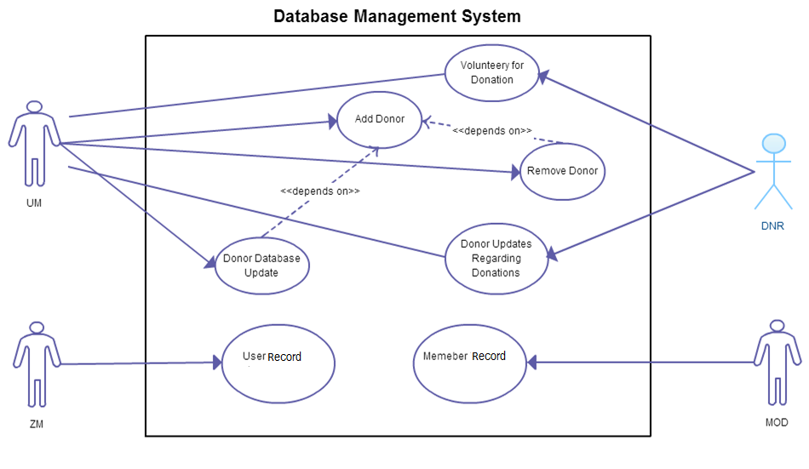
Fig : Use-Case Diagram for Database Management System

Slide 6
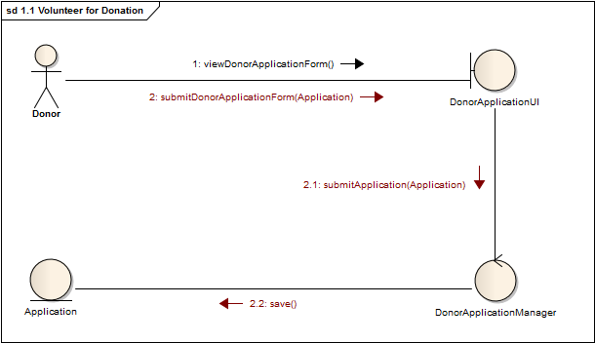
1.1 Volunteer for donation
Figure 1.1.1 – Collaboration Diagram

Slide 7
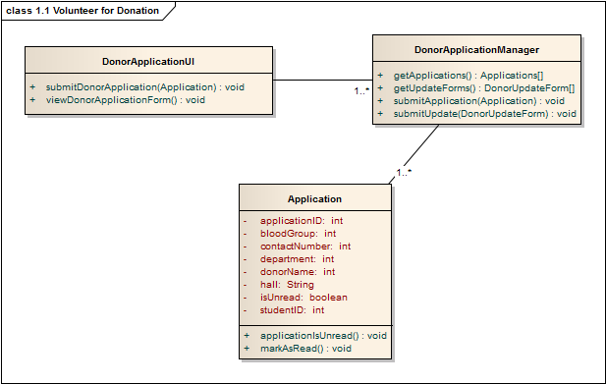
1.1 Volunteer for donation
Figure 1.1.2 – Class Diagram

Slide 8
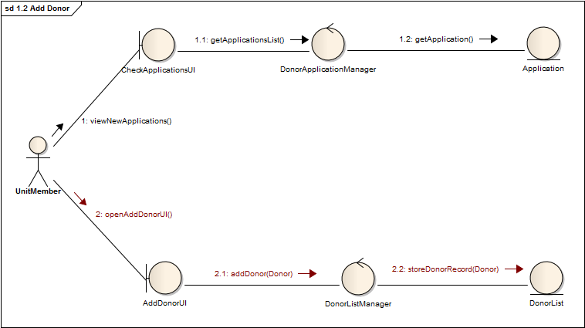
1.2 ADD DONOR
Figure 1.2.1 – Collaboration Diagram

Slide 9
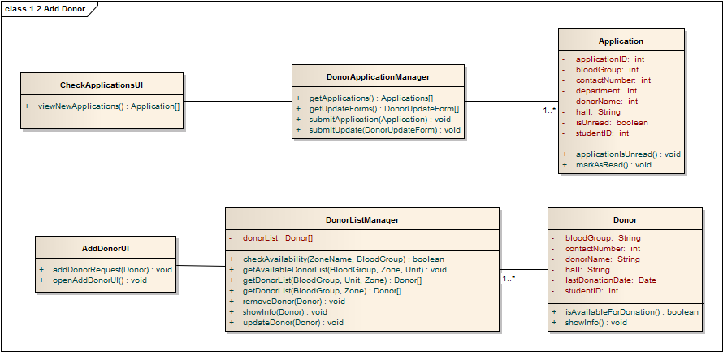
1.2 ADD DONOR
Figure 1.2.2 – Class Diagram

Slide 10
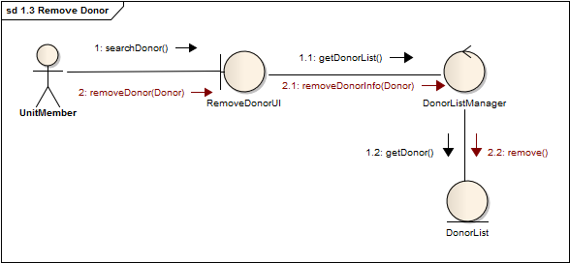
1.3 Remove donor
Figure 1.3.1 – Collaboration Diagram

Slide 11
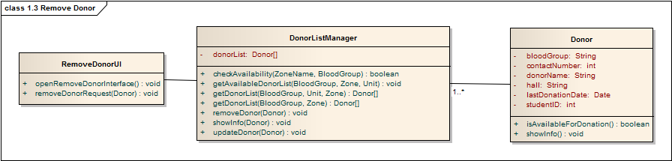
1.3 Remove donor
Figure 1.3.2 – Class Diagram

Slide 12
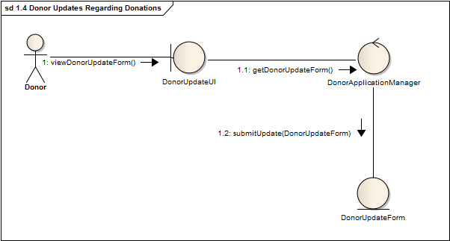
1.4 donor updates regarding donation
Figure 1.4.1 – Collaboration Diagram

Slide 13
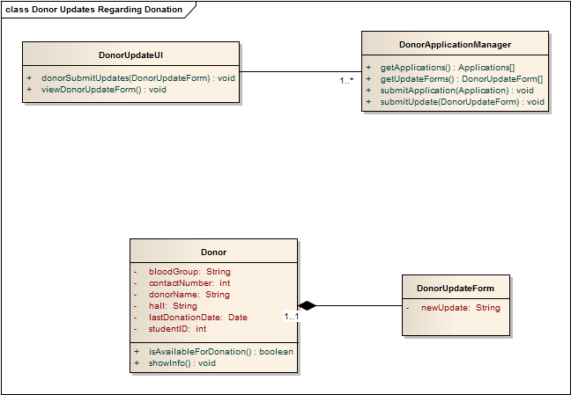
1.4 donor updates regarding donation
Figure 1.4.2 – Class Diagram

Slide 14
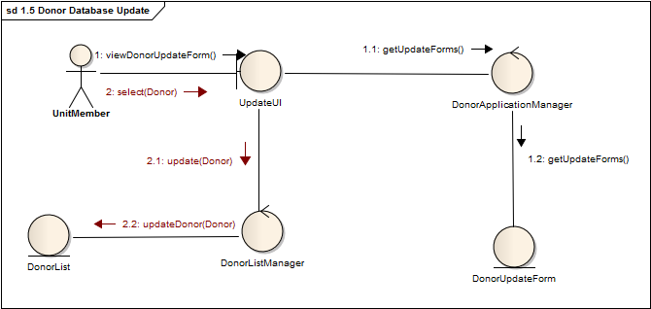
1.5 donor database update
Figure 1.5.1 – Collaboration Diagram

Slide 15
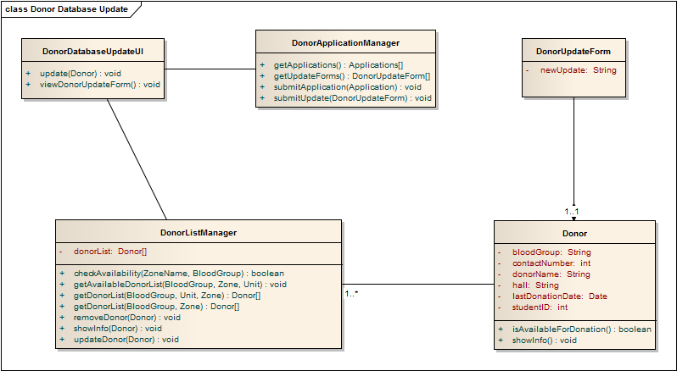
1.5 donor database update
Figure 1.5.2 – Class Diagram

Slide 16
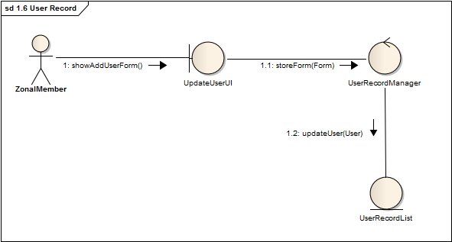
1.6 User record
Figure 1.6.1 – Collaboration Diagram

Slide 17
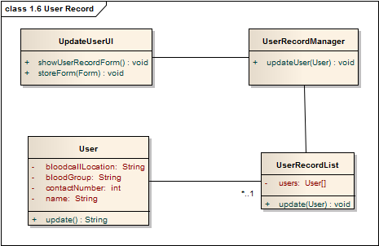
1.6 User record
Figure 1.6.2 – Class Diagram

Slide 18
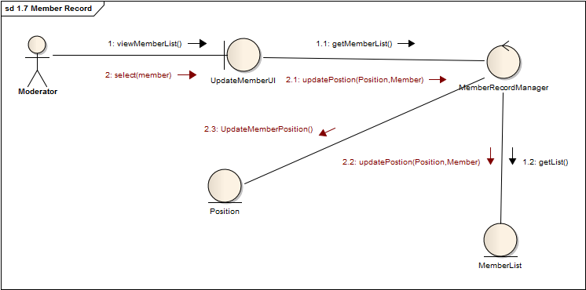
1.7 Member record
Figure 1.7.1 – Collaboration Diagram

Slide 19
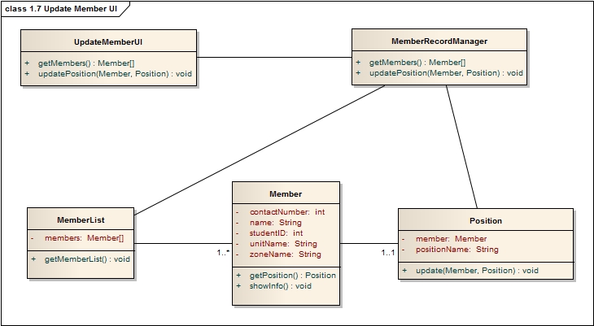
1.7 Member record
Figure 1.7.2 – Class Diagram

Slide 20
2. Search Management

Slide 21
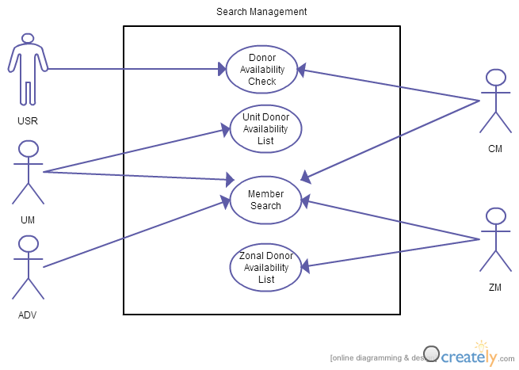
Fig : Use-Case Diagram for Search Management System

Slide 22
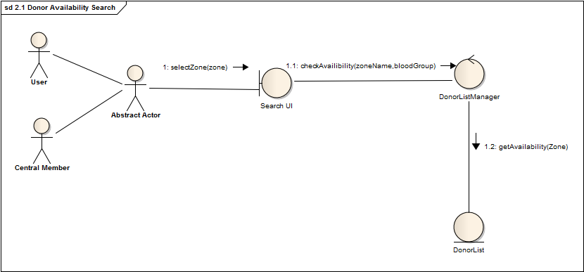
2.1 donor availability check
Figure 2.1.1 – Collaboration Diagram

Slide 23
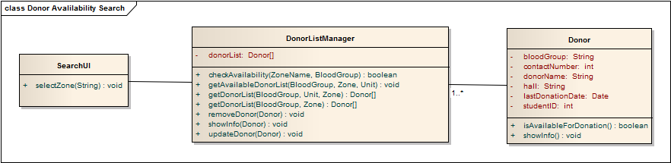
2.1 donor availability check
Figure 2.1.2 – Class Diagram

Slide 24
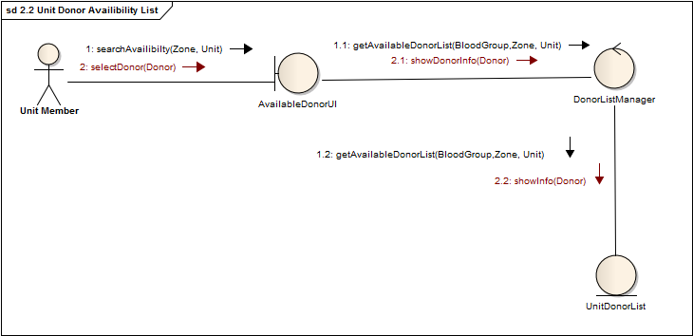
2.2 unit donor availability list
Figure 2.2.1 – Collaboration Diagram

Slide 25
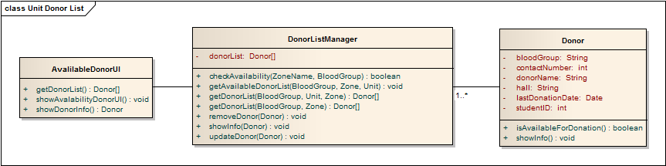
2.2 unit donor availability list
Figure 2.2.2 – Class Diagram

Slide 26
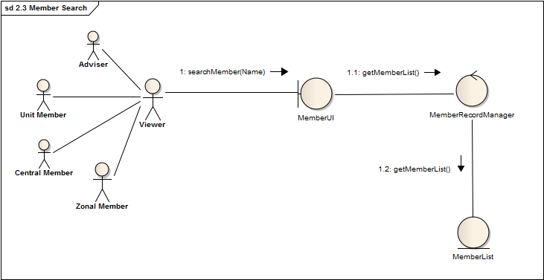
2.3 member search
Figure 2.3.1 – Collaboration Diagram

Slide 27
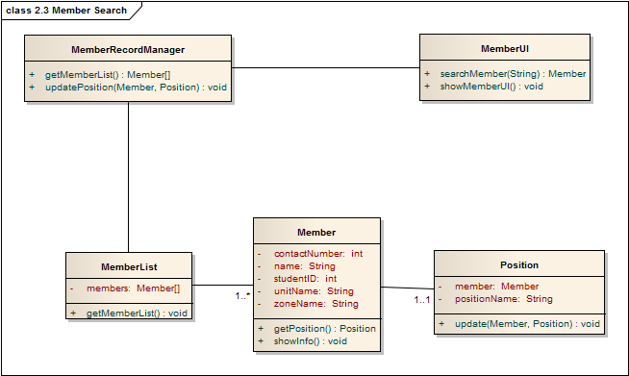
2.3 member search
Figure 2.3.2 – Class Diagram

Slide 28
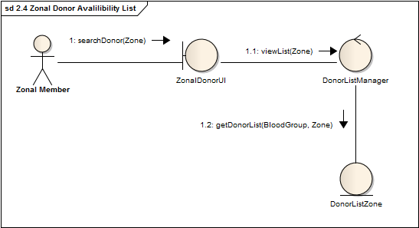
2.4 zonal donor availability list
Figure 2.4.1 – Class Diagram

Slide 29
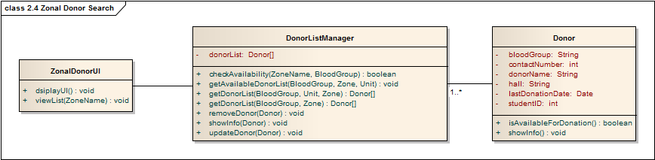
2.4 zonal donor availability list
Figure 2.4.2 – Class Diagram

Slide 30
Q&A
Any Questions?

Slide 31
Thank you

Slide 32
3. Meeting Management

Slide 33
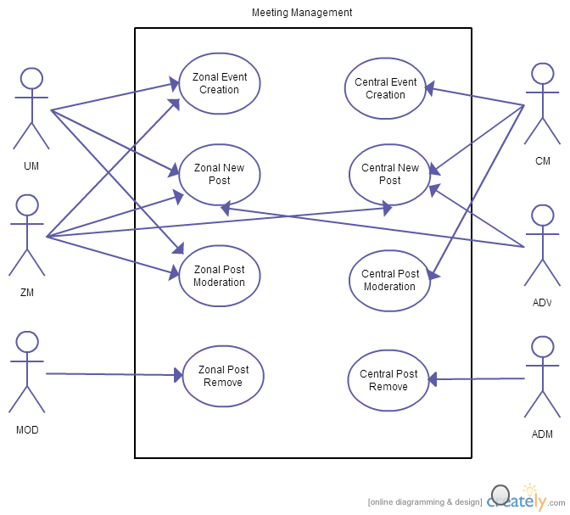
Fig : Use-Case Diagram for Meeting Management System

Slide 34
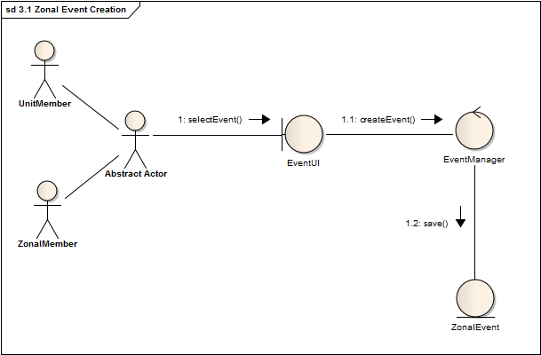
3.1 zonal event creation
Figure 3.1.1 – Collaboration Diagram

Slide 35
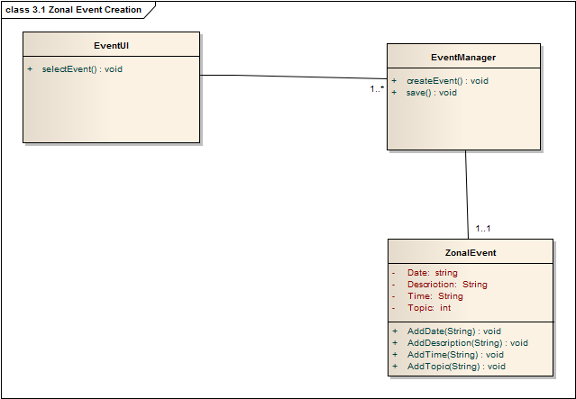
3.1 zonal event creation
Figure 3.1.2 – Class Diagram

Slide 36
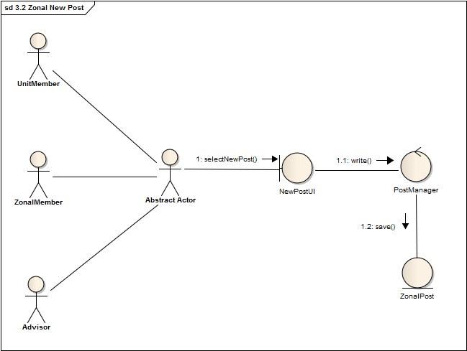
3.2 zonal new post
Figure 3.2.1 – Collaboration Diagram

Slide 37
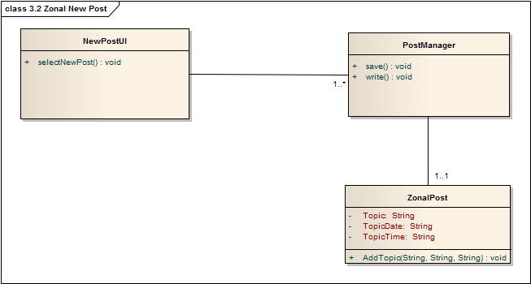
3.2 zonal new post
Figure 3.2.2 – Class Diagram

Slide 38
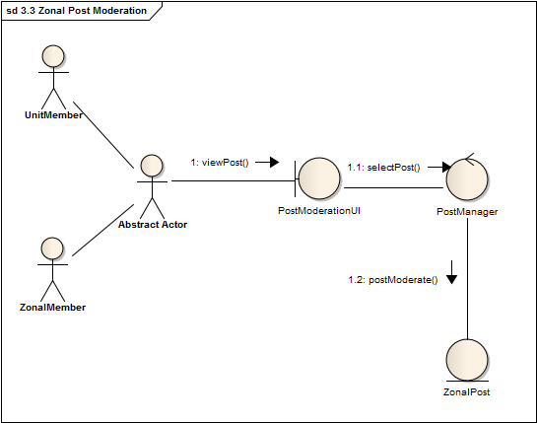
3.3 zonal post moderation
Figure 3.3.1 – Collaboration Diagram

Slide 39
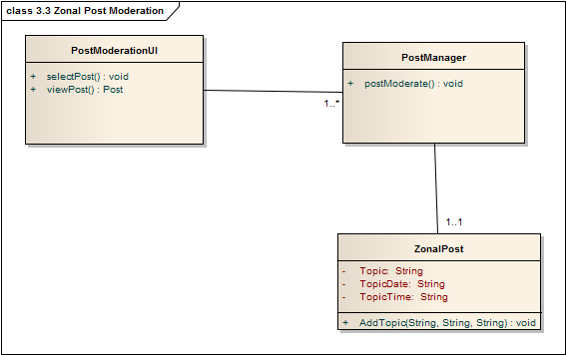
3.3 zonal post moderation
Figure 3.3.2 – Class Diagram

Slide 40
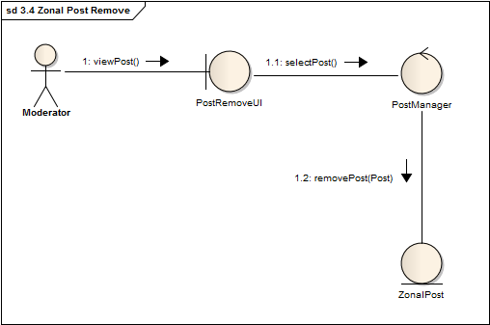
3.4 zonal post remove
Figure 3.4.1 – Collaboration Diagram

Slide 41
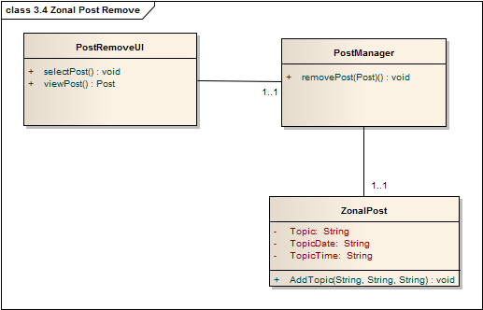
3.4 zonal post remove
Figure 3.4.2 – Class Diagram

Slide 42
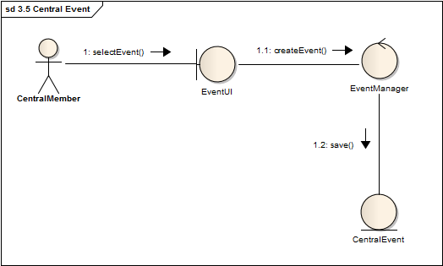
3.5 central event creation
Figure 3.5.1 – Collaboration Diagram

Slide 43
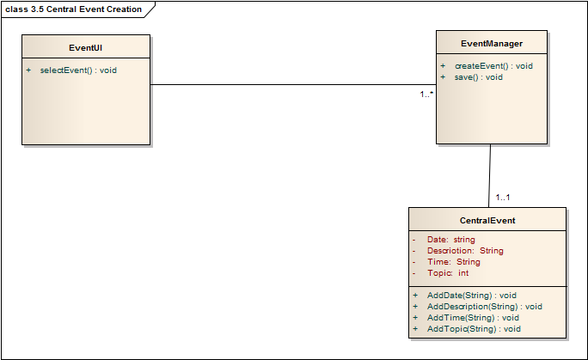
3.5 central event creation
Figure 3.5.2 – Class Diagram

Slide 44
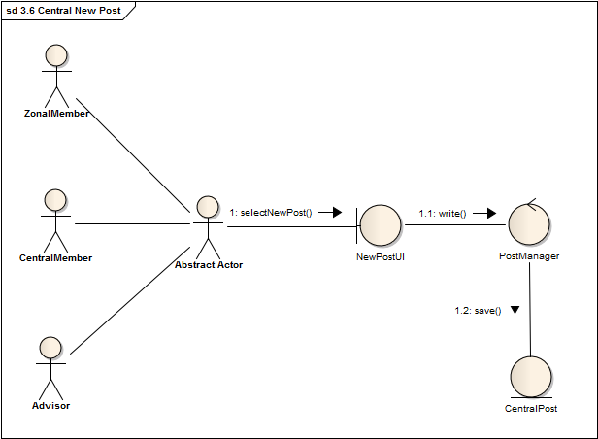
3.6 central new post
Figure 3.6.1 – Collaboration Diagram

Slide 45
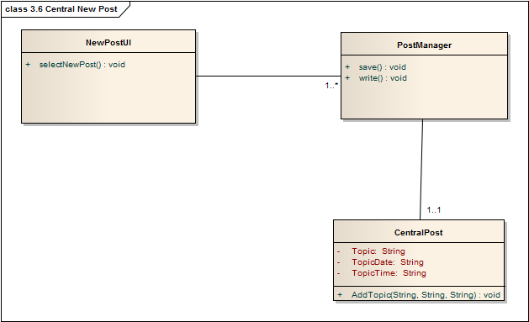
3.6 central new post
Figure 3.6.2 – Class Diagram

Slide 46
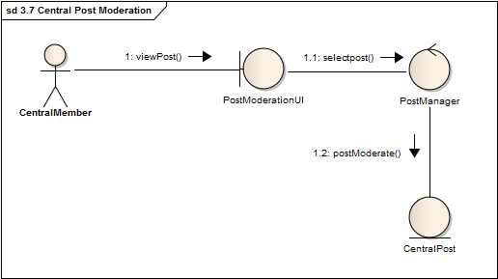
3.7 central post moderation
Figure 3.7.1 – Collaboration Diagram

Slide 47
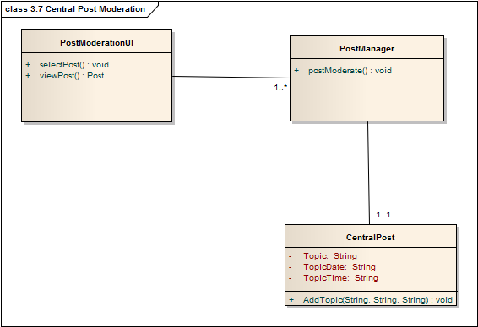
3.7 central post moderation
Figure 3.7.2 – Class Diagram

Slide 48
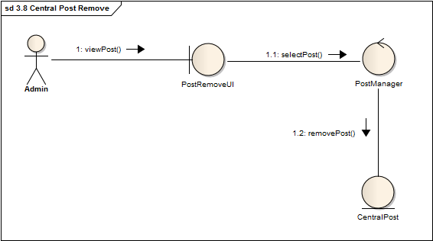
3.8 central post remove
Figure 3.8.1 – Collaboration Diagram

Slide 49
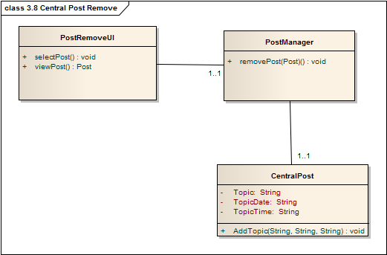
3.8 central post remove
Figure 3.8.2 – Class Diagram

Slide 50
4. Notification Management

Slide 51
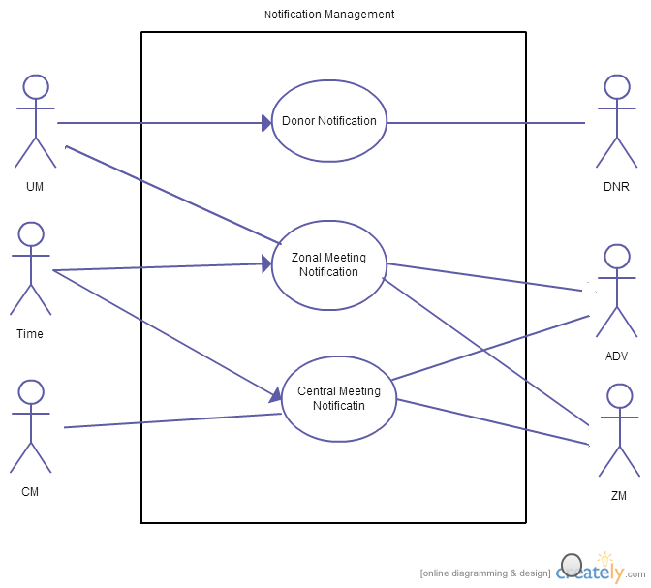
Fig : Use-Case Diagram for Notification Management System

Slide 52
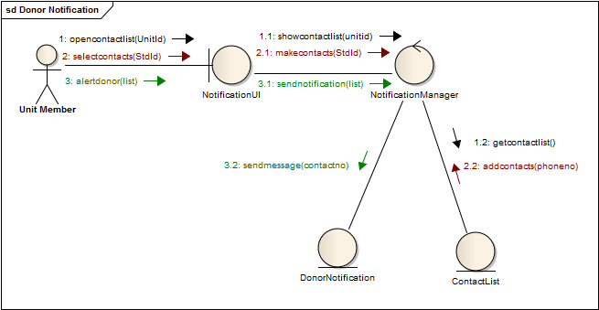
4.1 donor notification
Figure 4.1.1 – Collaboration Diagram

Slide 53
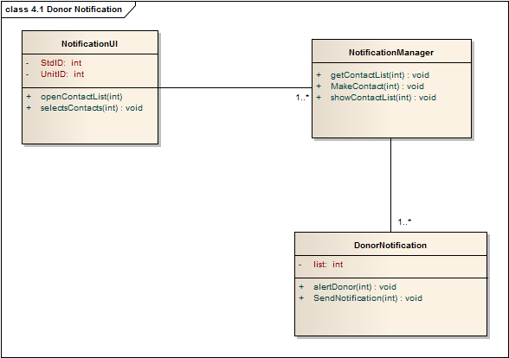
4.1 donor notification
Figure 4.1.2 – Class Diagram

Slide 54
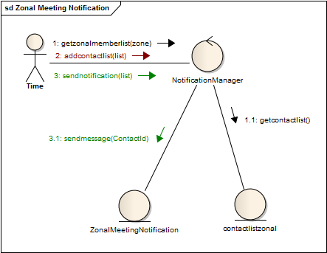
4.2 Zonal meeting notification
Figure 4.2.1 – Collaboration Diagram

Slide 55
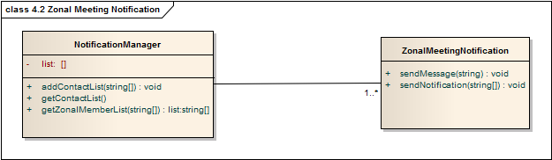
4.2 Zonal meeting notification
Figure 4.2.2 – Class Diagram

Slide 56
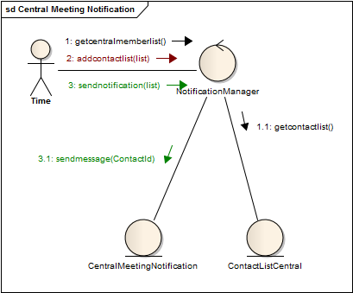
4.3 central meeting notification
Figure 4.3.1 – Collaboration Diagram

Slide 57
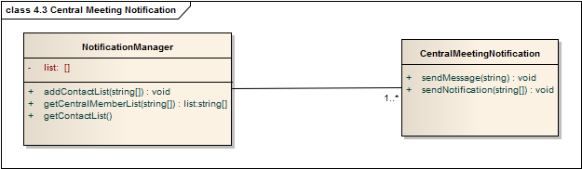
4.3 central meeting notification
Figure 4.3.2 – Class Diagram

Slide 58
5. Automated Requisition Form Verification

Slide 59
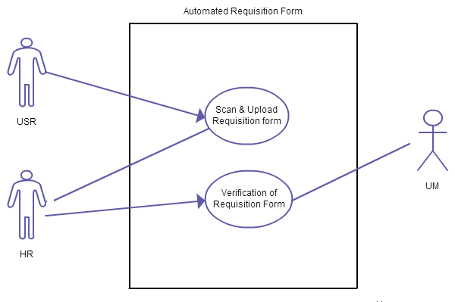
Fig : Use-Case Diagram for Automated Requisition Form Verification

Slide 60
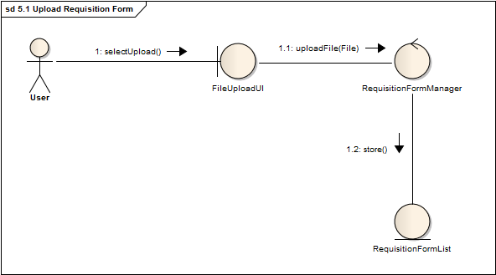
5.1 upload requisition form
Figure 5.1.1 – Collaboration Diagram

Slide 61

5.1 upload requisition form
Figure 5.1.2 – Class Diagram

Slide 62

5.2(a) Verification of requisition form
Figure 5.2(A).1 – Collaboration Diagram

Slide 63

5.2(a) Verification of requisition form
Figure 5.2(A).2 – Class Diagram

Slide 64

5.2(b) Verification of requisition form
Figure 5.2(B).1 – Collaboration Diagram

Slide 65
5.2(B) Verification of requisition form
Figure 5.2(B).2 – Class Diagram

